Slide 1
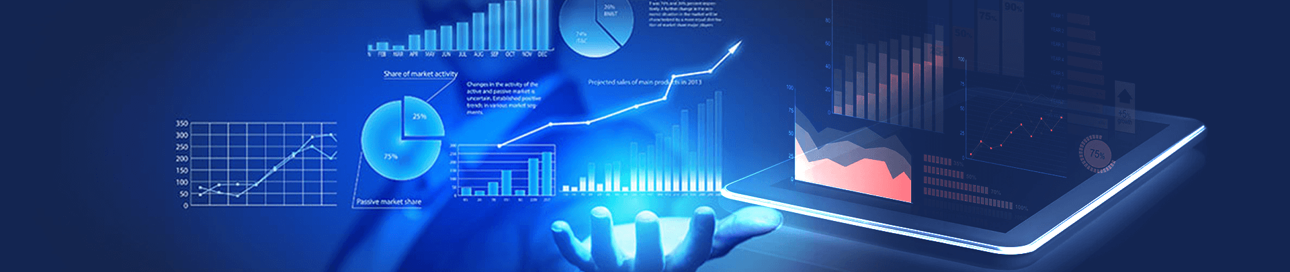
DATA ANALYTICS
WORKSHOP
Presenter: Miss Ilma
17TH FEB 2024

Slide 2

About Me:
Educator | Developer | Tech Enthusiast
Educational Qualification:
Masters in Data Science (IU Germany)
PGP in AI & ML (University of Texas)
B.tech (ECE)
Professional Experience:
Software Developer
Corporate Experience: 8 Yrs.
Ex TCSer
Socials:
LinkedIn: www.linkedin.com/in/ilma-ila
IG: instagram.com/ilma_ila_
Centre IG: instagram.com/caddcentrenfc
ILMA

Slide 3
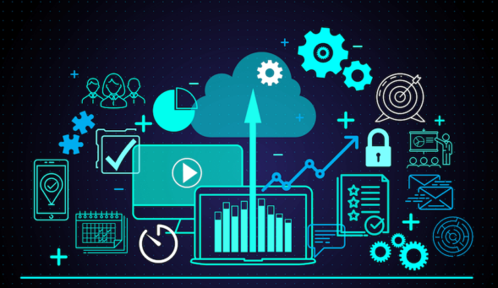


What is Data Analysis?
The science of analyzing raw data to make conclusions about the information.
Data analytics is the practice of examining raw data to identify trends, draw conclusions, and extract meaningful information. This involves various techniques and tools to process and transform data into valuable insights that can be used for decision-making.
All rights reserved

Slide 4
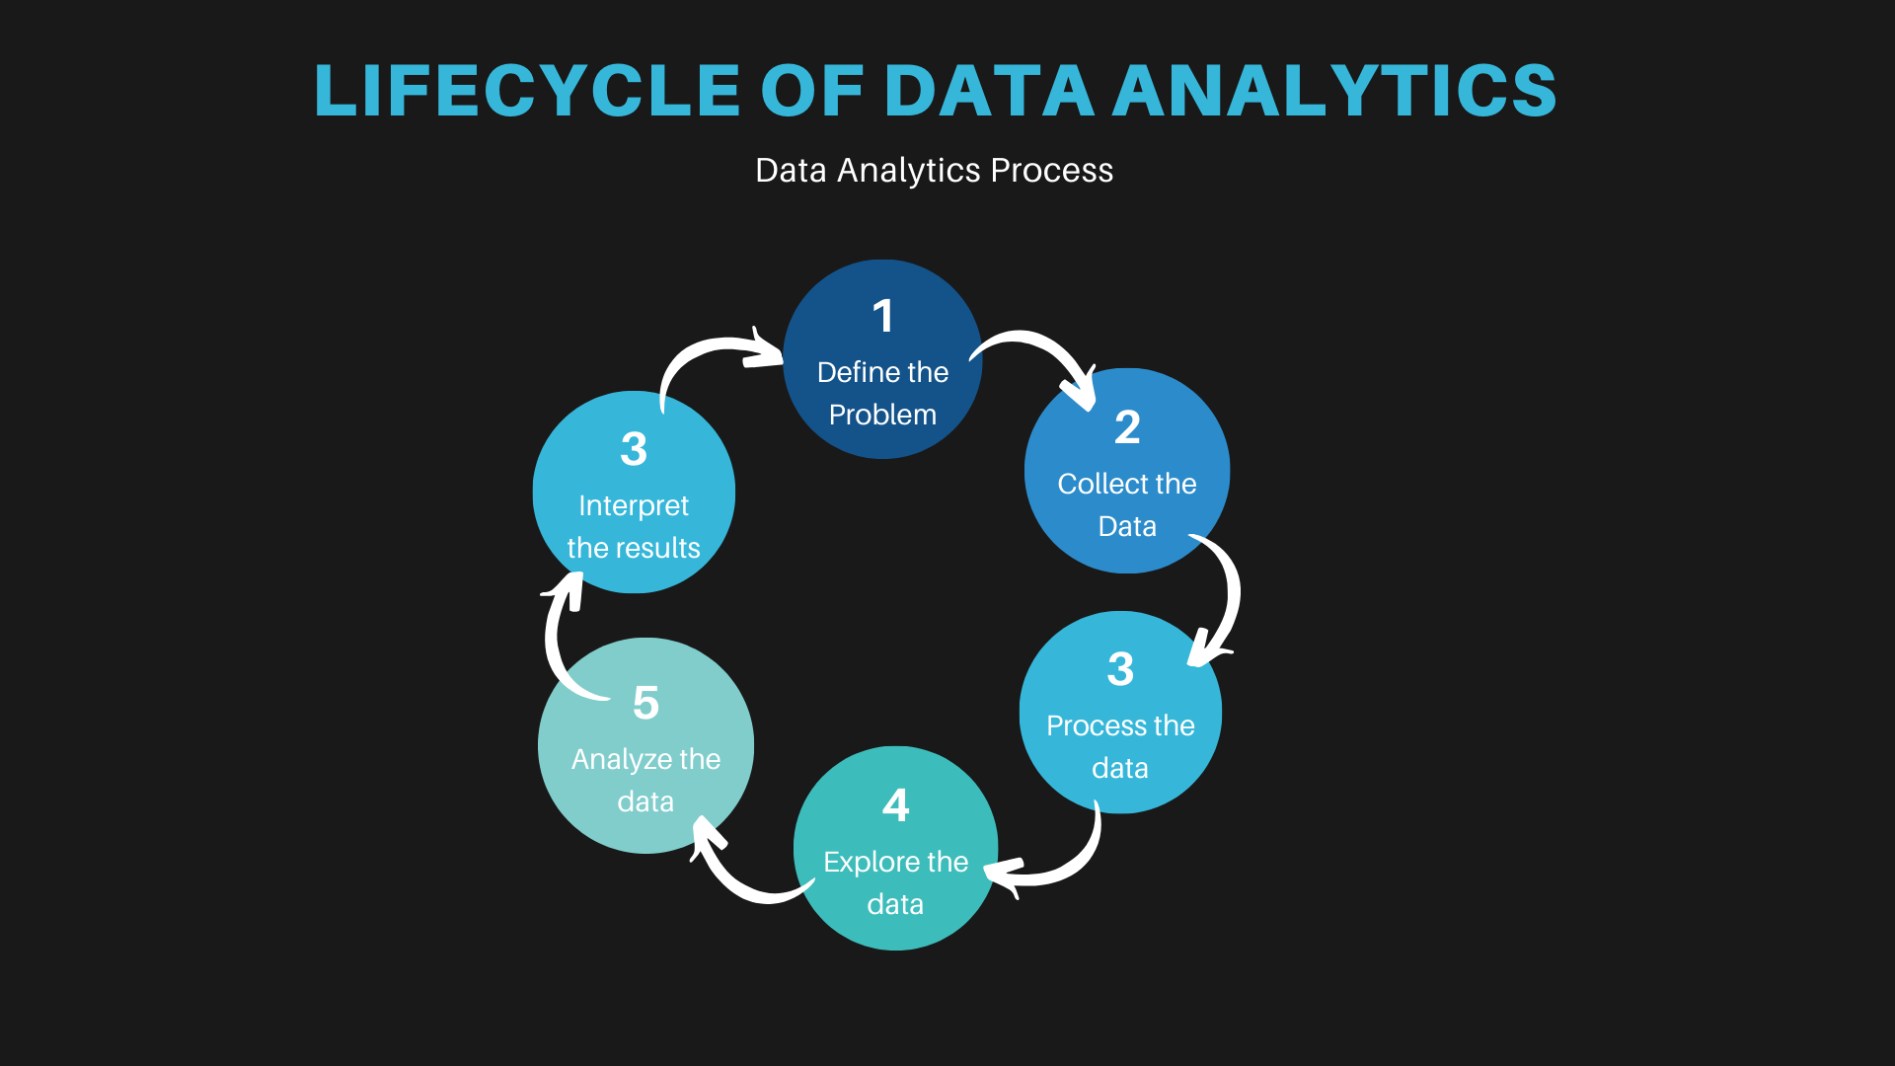

Slide 5
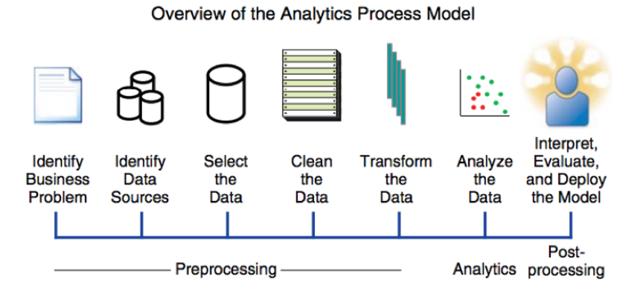
Data Analytics Process
All rights reserved

Slide 6
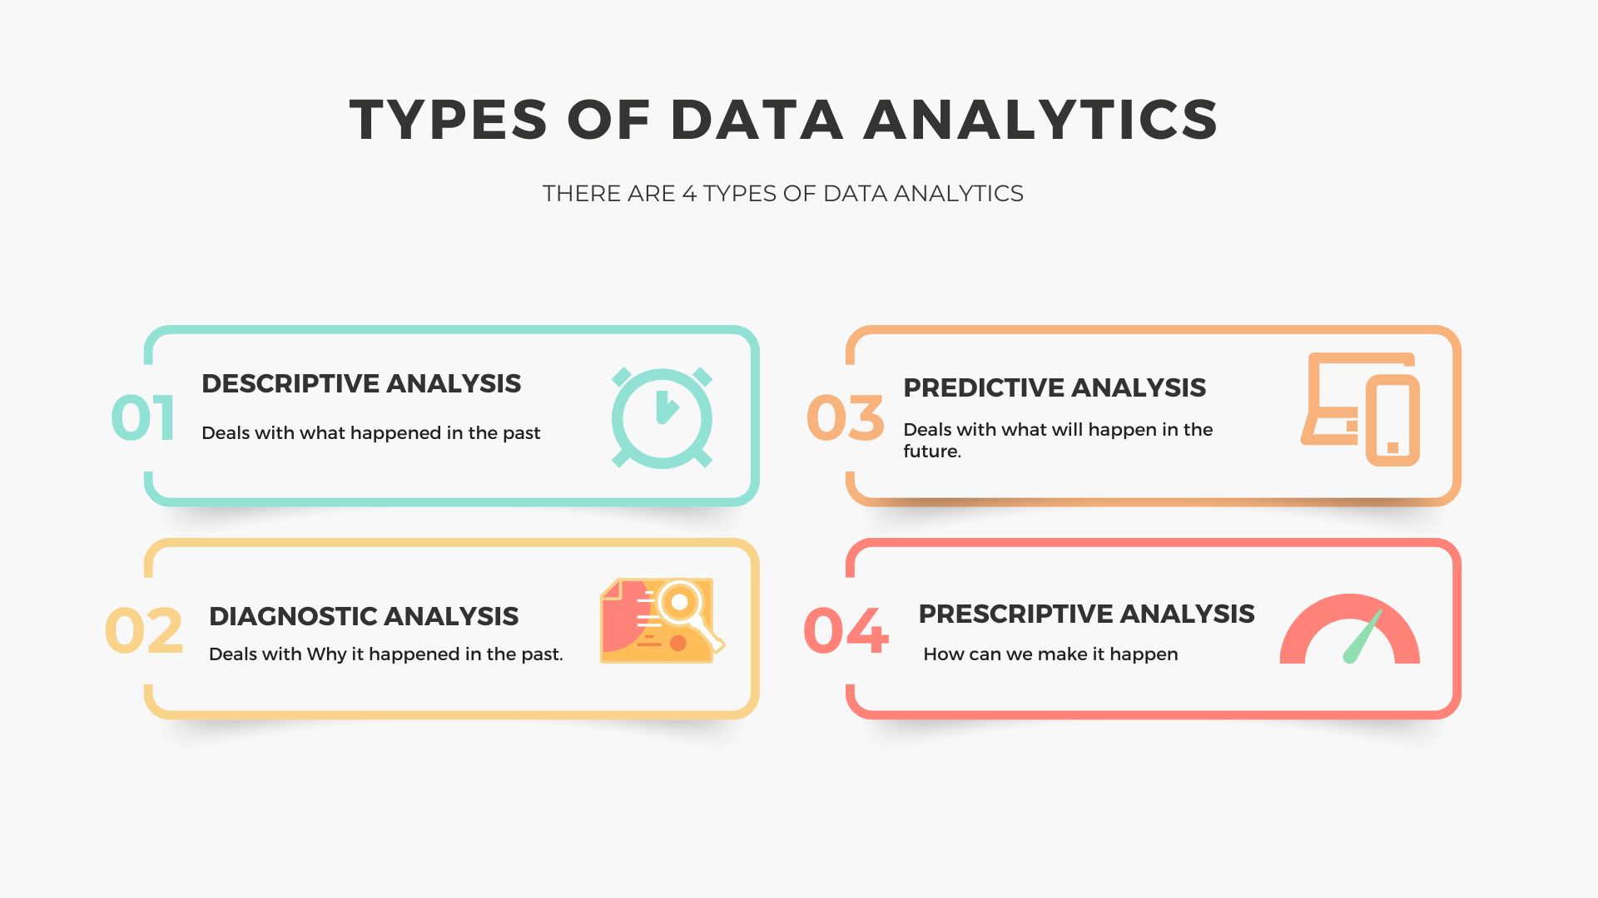
All rights reserved

Slide 7

Why Data Analytics?

Slide 8
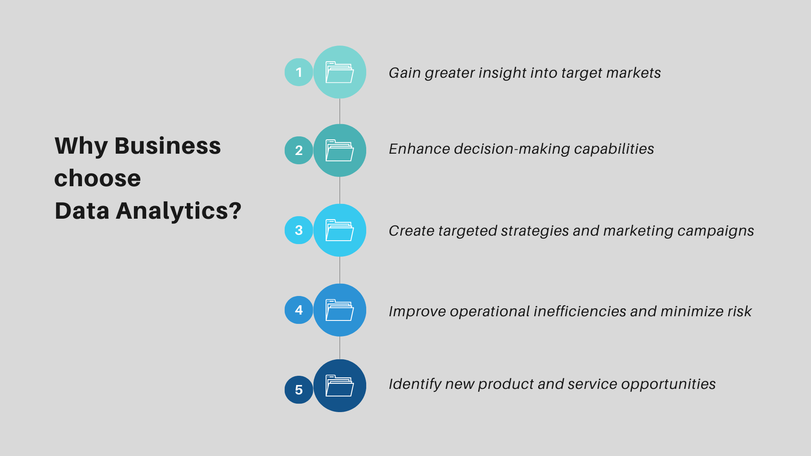
All rights reserved

Slide 9
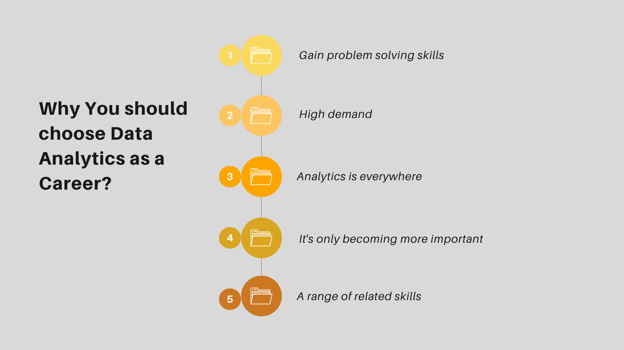
All rights reserved

Slide 10
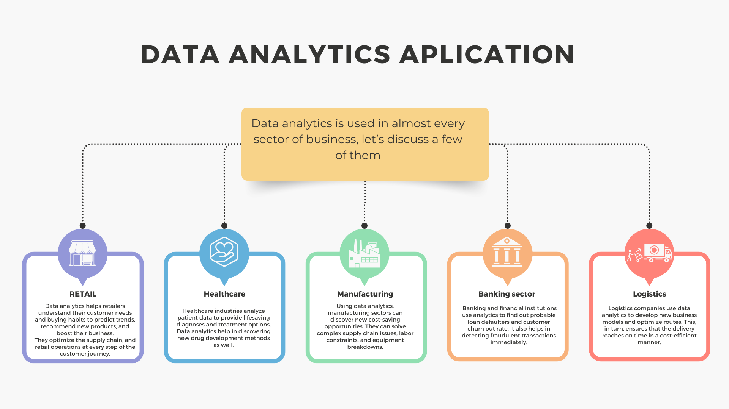
All rights reserved

Slide 11
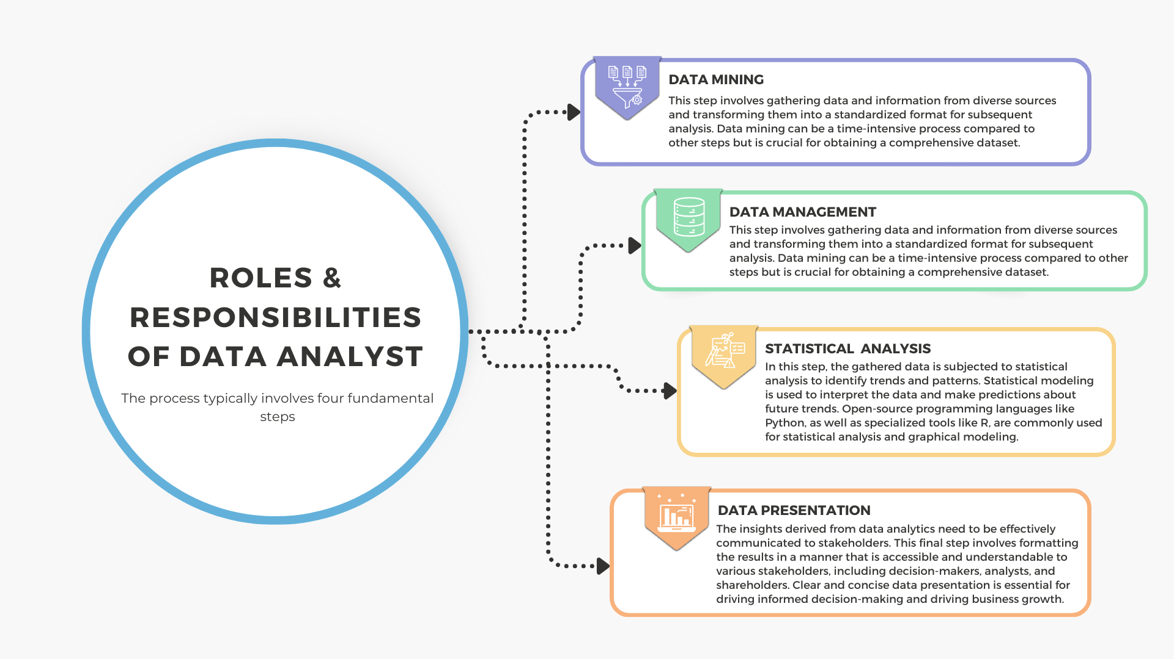
All rights reserved

Slide 12
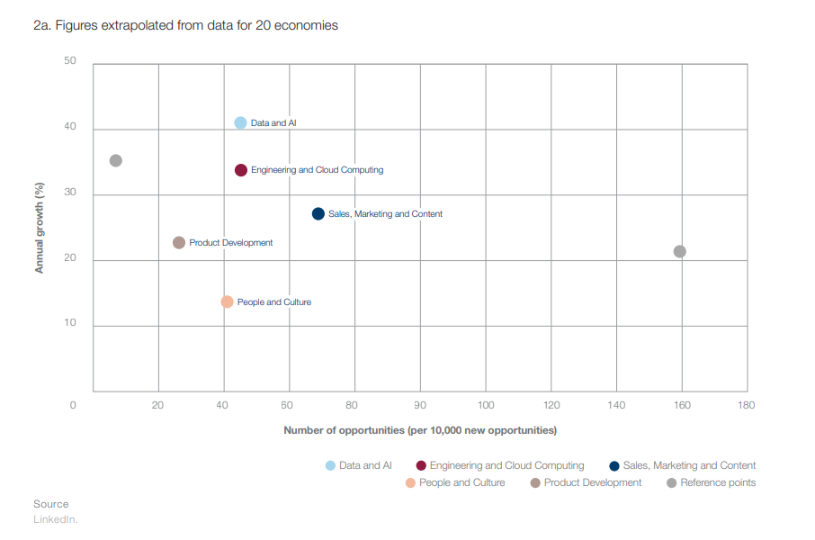
Future Scope of Data Analyst
World Economic Forum – Jobs of Tomorrow

Slide 13
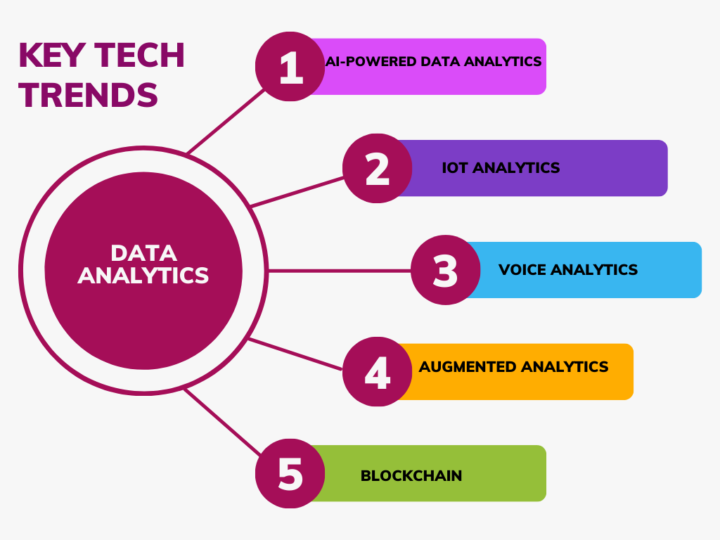
All rights reserved

Slide 14

Can Anyone
Become a
Data Analyst Without Any Experience?

Slide 15
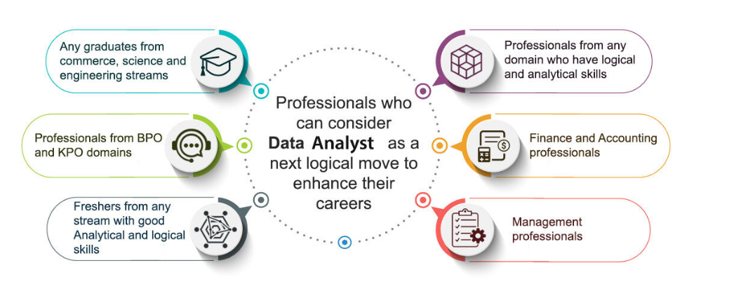
WHO SHOULD DO THE DATA ANALYTICS COURSE?
All rights reserved

Slide 16
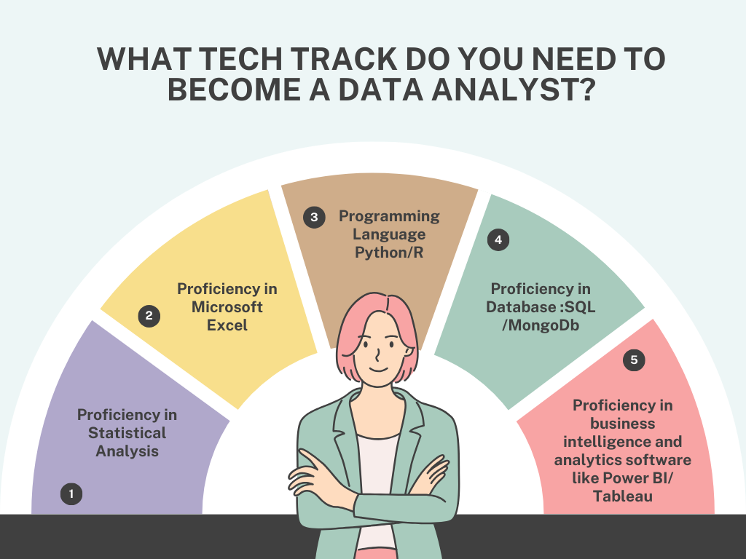
TECH TOOLS USED IN DATA ANALYTICS
All rights reserved

Slide 17
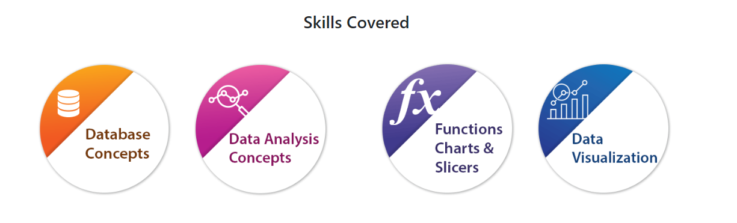
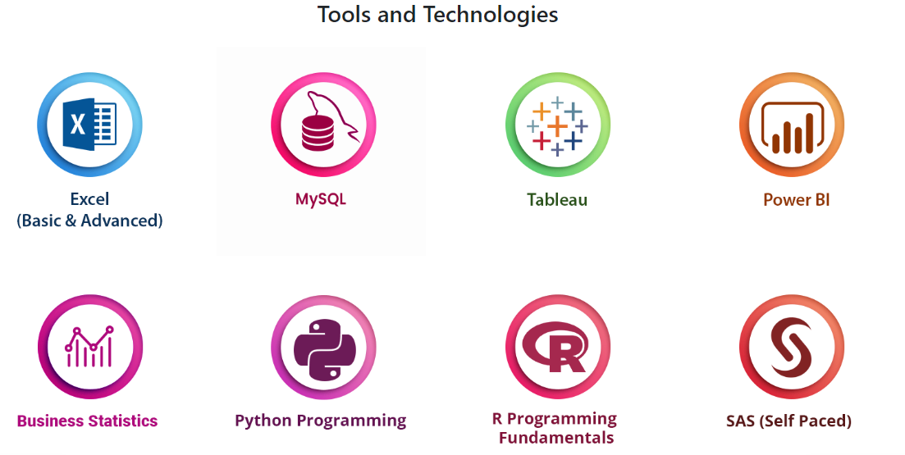
TECH TOOLS USED IN DATA ANALYTICS

Slide 18
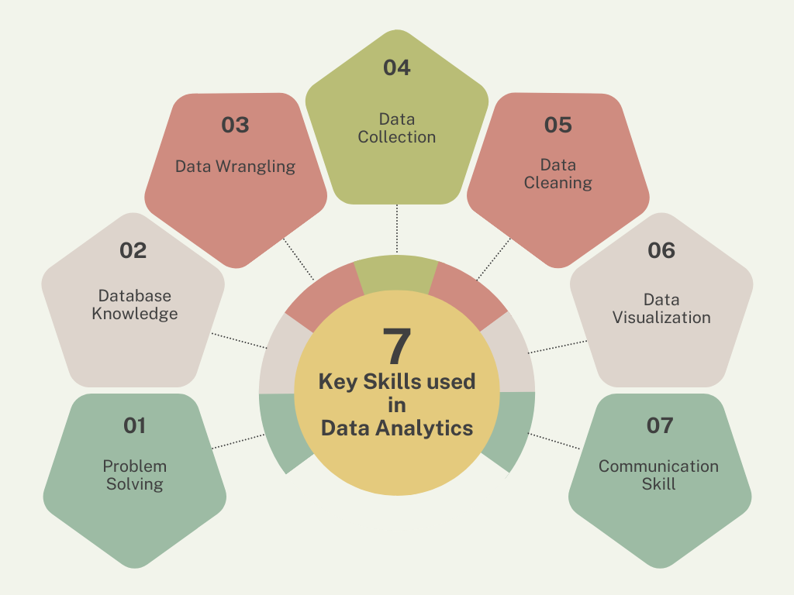

Slide 19

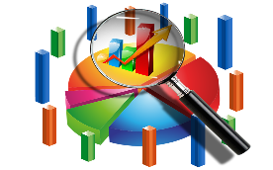



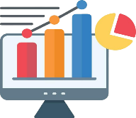
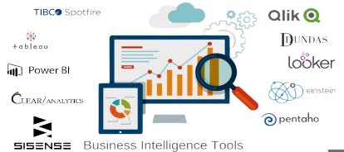

Data Analyst
Roadmap –
Skills Required
Starting Point
Statistics
Python /
R
SQL
Excel
Data
Visualization
BI Tools
Being
Awesome!
All rights reserved

Slide 20
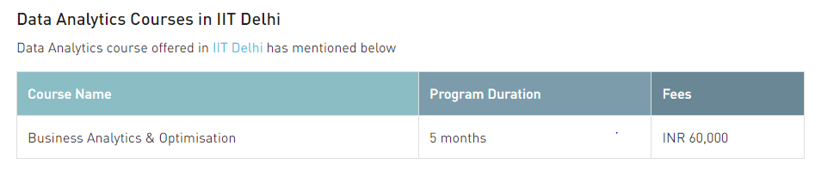
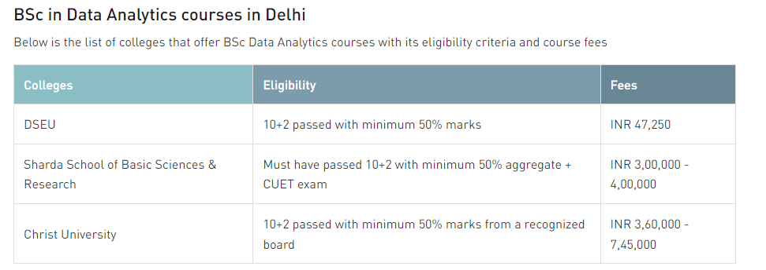
COURSES IN DATA ANALYTICS

Slide 21
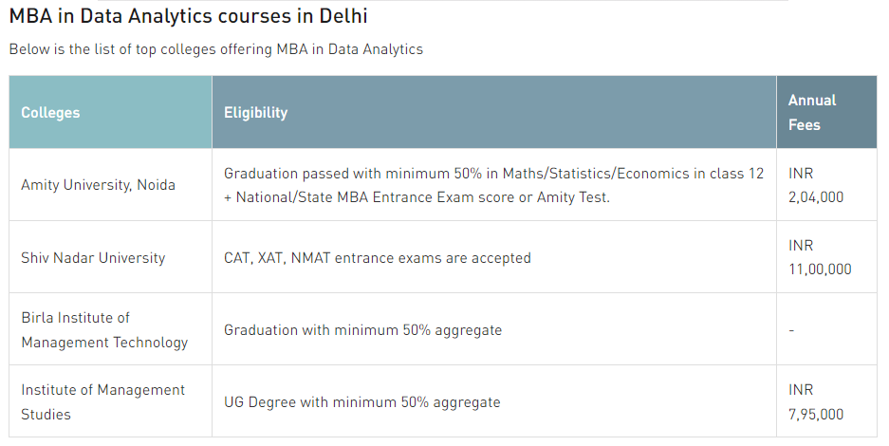
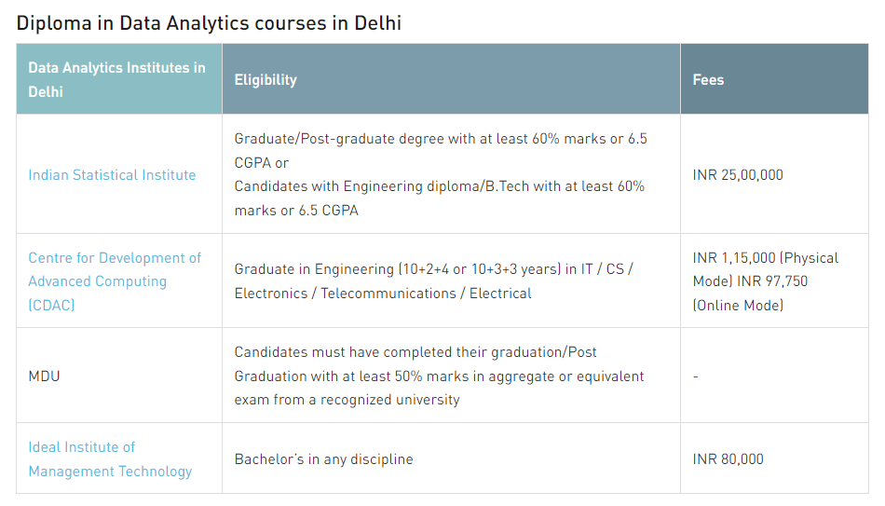
COURSES IN DATA ANALYTICS

Slide 22
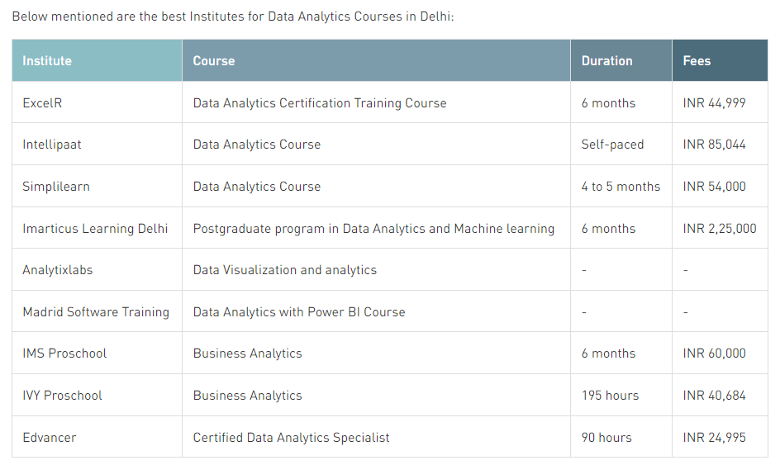
Comparison of Courses available in Market

Slide 23
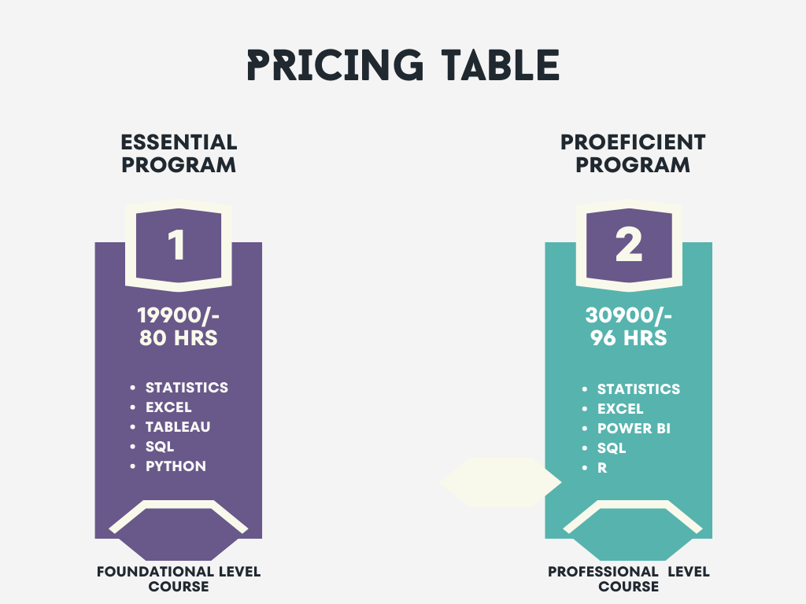

Slide 24
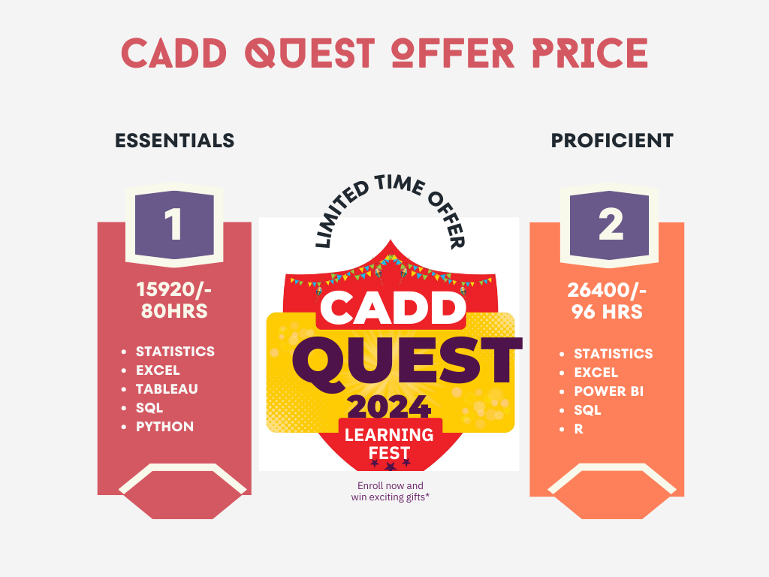
VALID TILL 31ST MARCH 2024

Slide 25
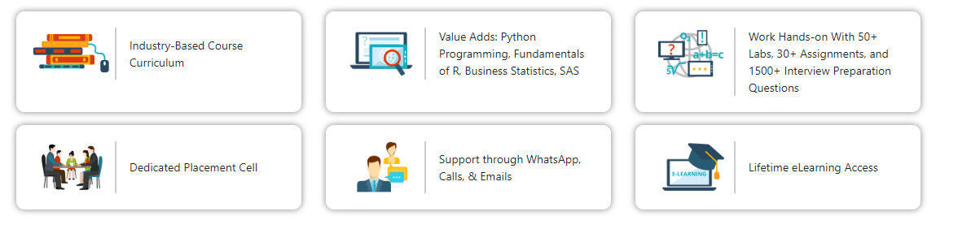
WHY CHOOSE US?
All rights reserved

Slide 26
FAQs
1. How To Become a Data Analyst?
2. What does Data Analyst do?
3. What can I do after the 12th to become a data analyst?
4. What is the future of the data analytics industry in 2024?
5. What does a data analyst do?
6. What is the typical background of a data analyst?
7. What skills do you need to become a data analyst?
8. Data analyst roadmap: your 5-step plan
9. Key takeaways and next steps
All rights reserved

Slide 27
THANK YOU!
All rights reserved

